Slide 1
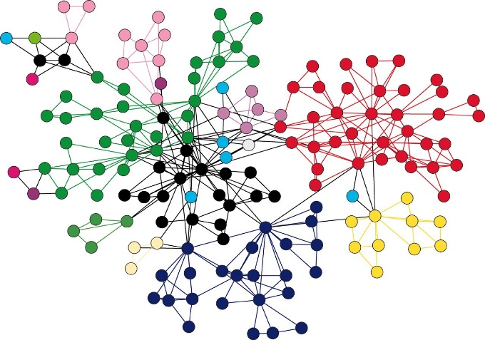
Chapter 29: Graphs
Manar Mohamed
mohamem@miamioh.edu

Slide 2
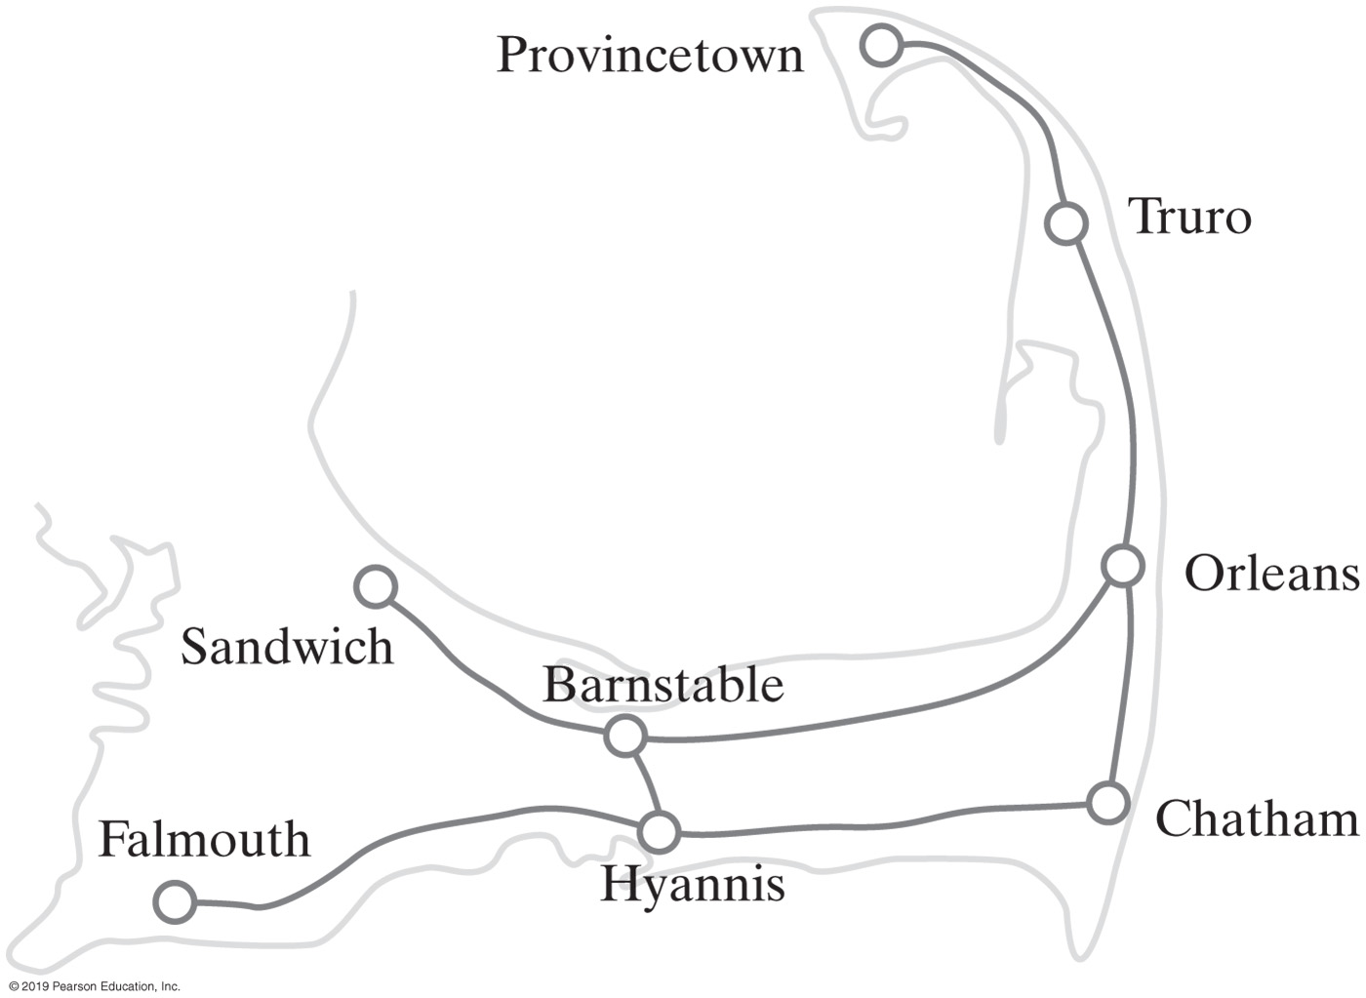
Graphs
A road map is a graph
Definition of a graph:
A collection of distinct nodes (vertices)
and distinct edges
In the map of Figure 29-1
The circles are vertices or nodes
The lines are called edges
A subgraph is a portion of a graph that is itself a graph
FIGURE 29-1 A portion of a road map

Slide 3
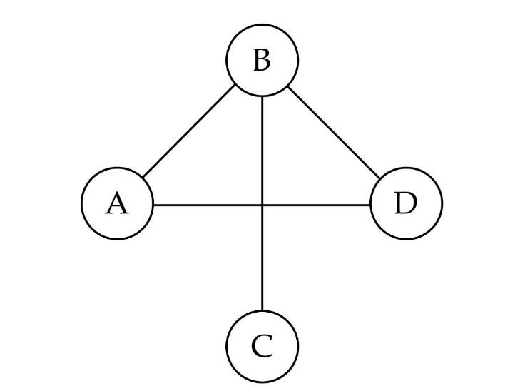
Directed vs. undirected graphs
When the edges in a graph have no direction, the graph is called undirected

Slide 4

Directed vs. undirected graphs (cont.)
When the edges in a graph have a direction, the graph is called directed (or digraph)
Warning: if the graph is directed, the order of the vertices in each edge is important !!

Slide 5

Trees vs graphs
Trees are special cases of graphs!!

Slide 6
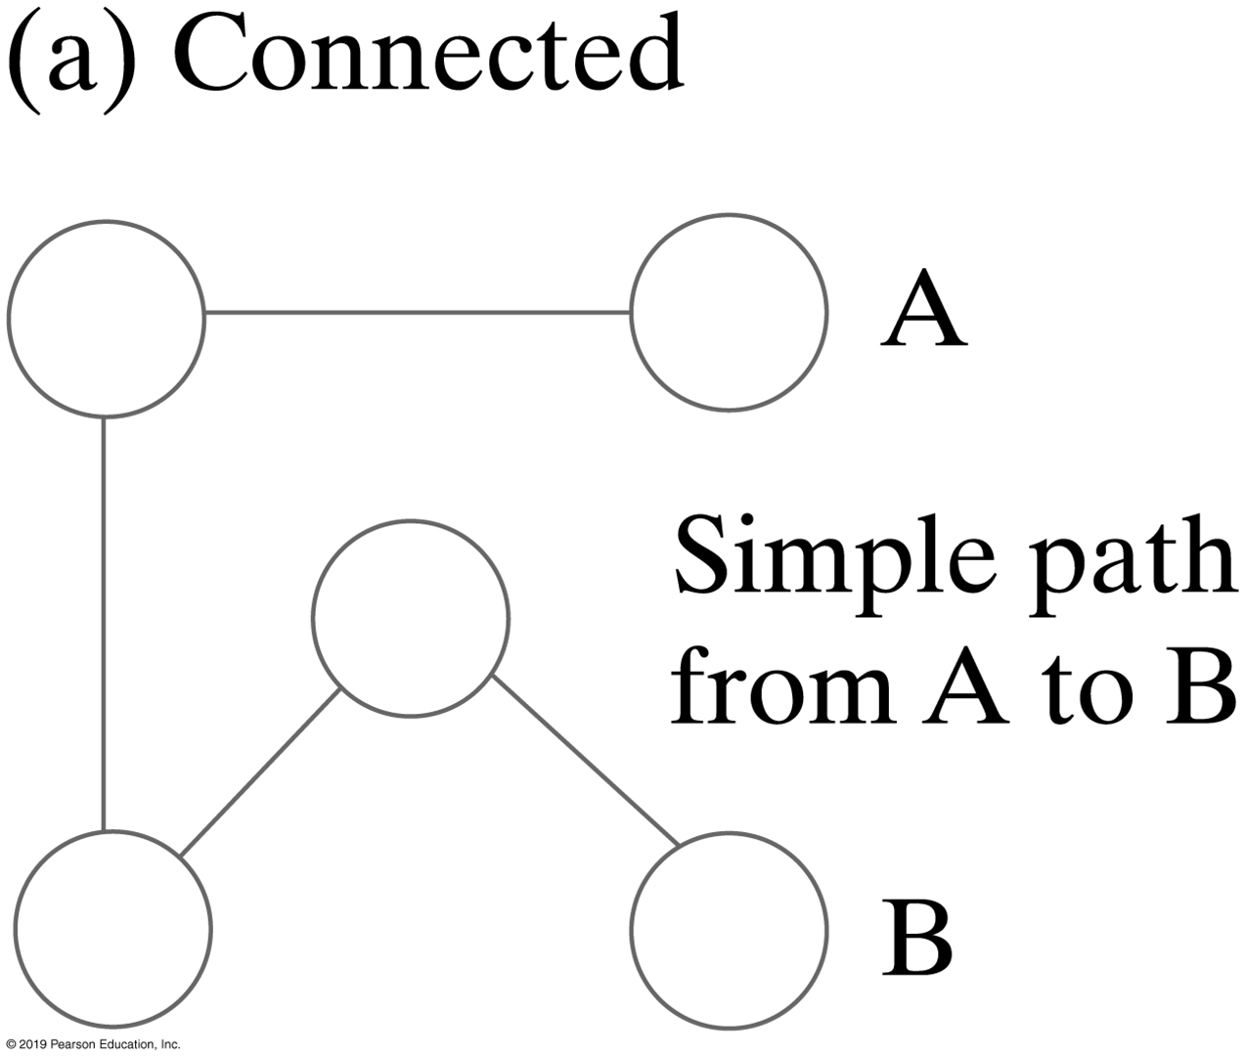
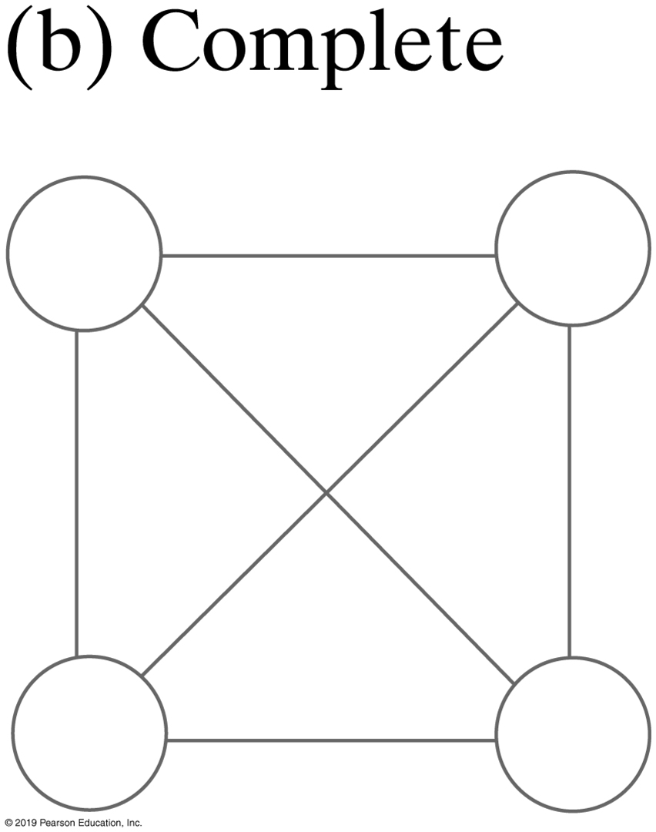
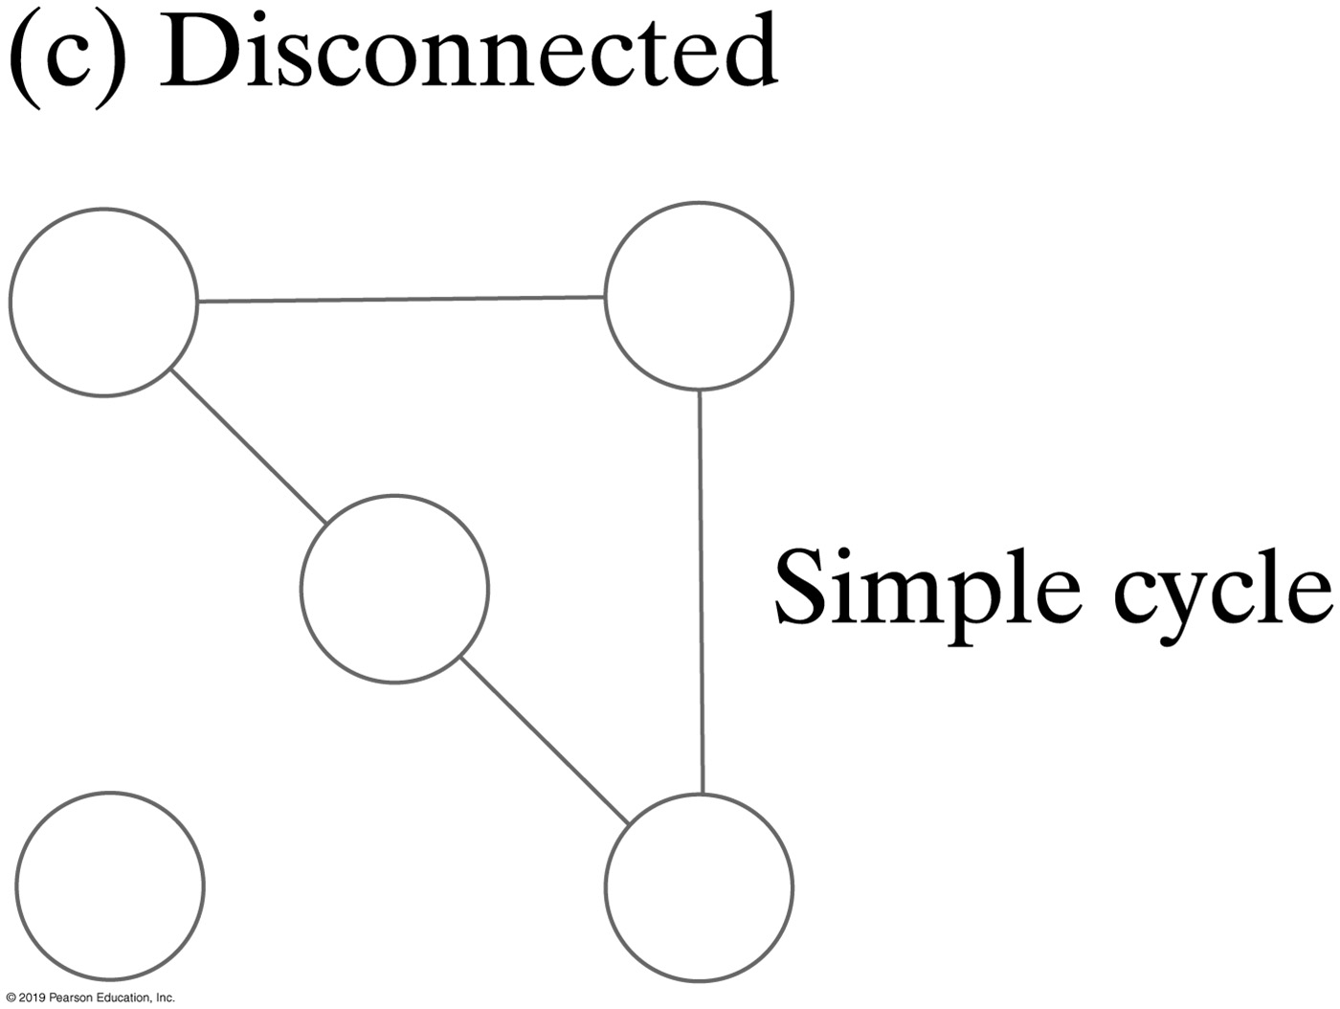
Connected Graphs
A graph that has a path between every pair of distinct vertices is connected
A complete graph has an edge between every pair of distinct vertices.
Undirected graphs can be
Connected
Complete or
Disconnected

Slide 7
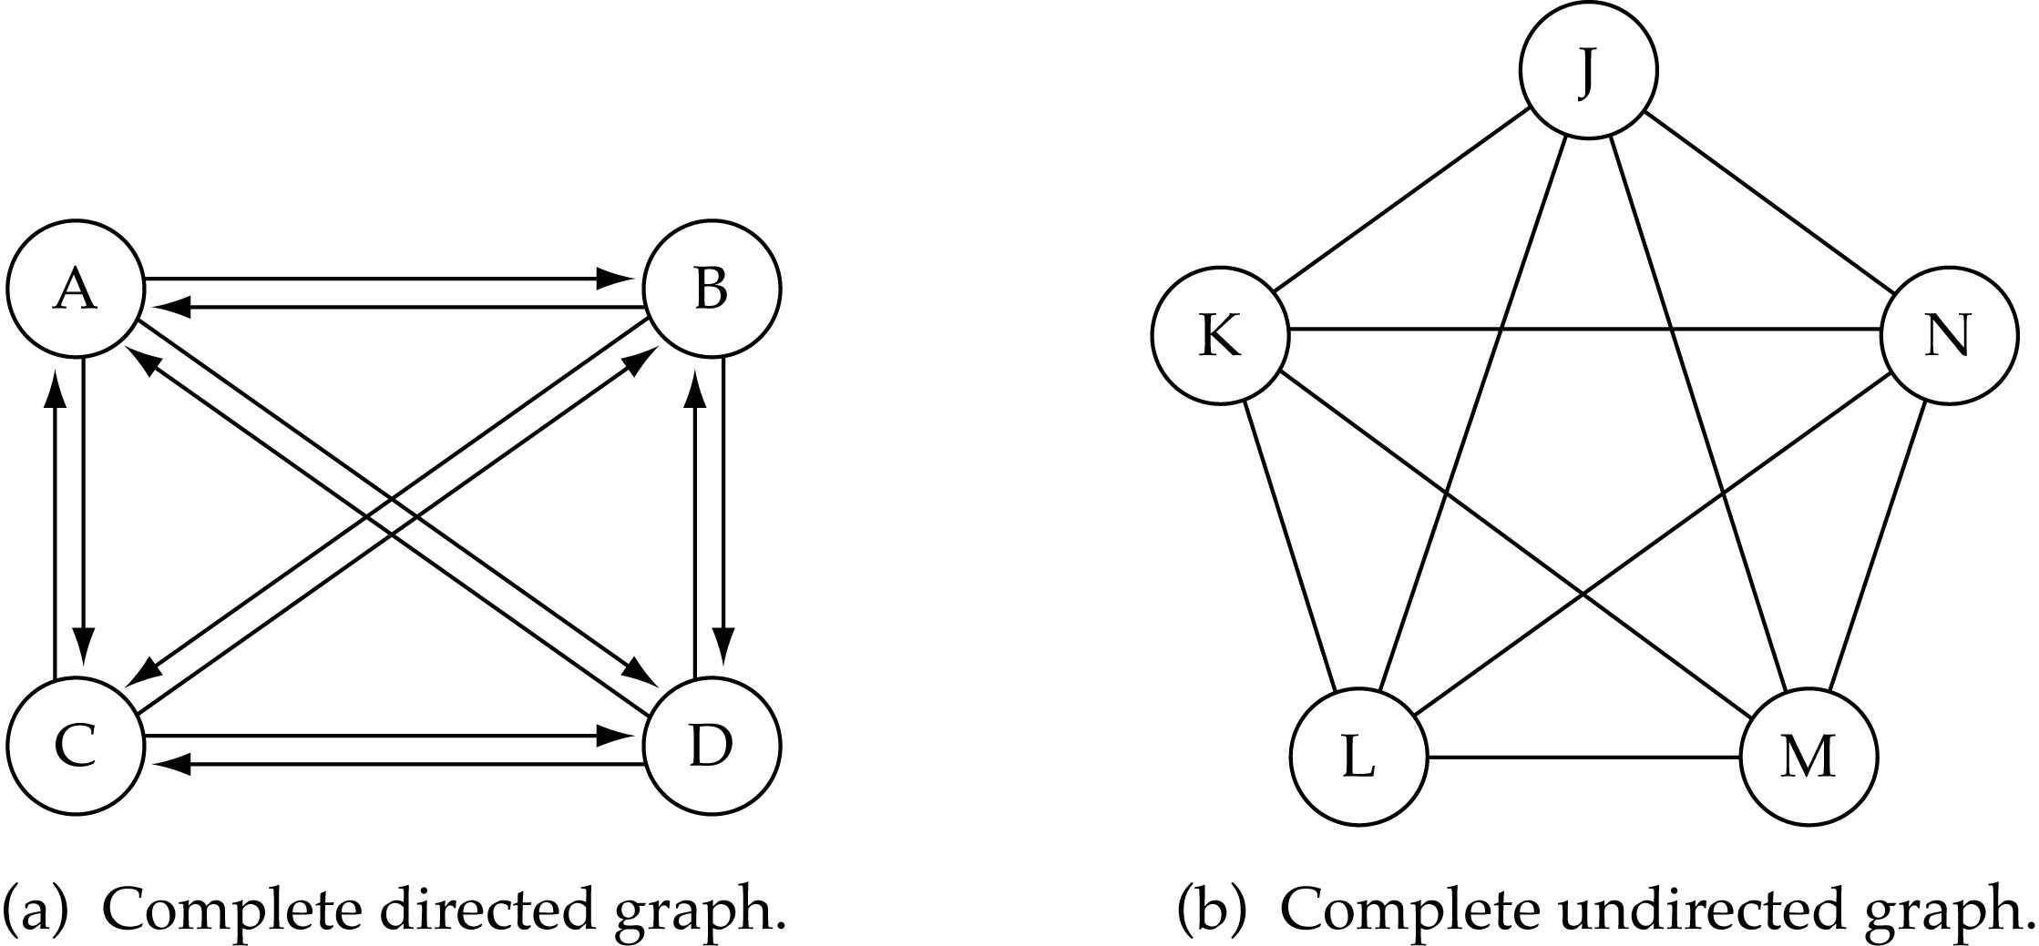
Connected Graphs
What is the number of edges in a complete directed graph with N vertices?
N * (N-1)

Slide 8
Connected Graphs
What is the number of edges in a complete undirected graph with N vertices?
N * (N-1) / 2

Slide 9
Number of Edges
A graph is sparse if it has relatively few edges
A graph is dense if it has many edges

Slide 10

Adjacent nodes
In undirected graph, two nodes are adjacent if they are connected by an edge
In directed graph, node i is adjacent to node j, if there is a directed edge begin at j and ends at i
Vertex A is adjacent to vertex B,
but B is not adjacent to A

Slide 11
Paths
A path between two vertices in a graph is a sequence of edges
A path in a directed graph must consider the direction of the edges
Called a directed path
The length of a path is the number of edges that it comprises.
A cycle is a path that begins and ends at the same vertex

Slide 12
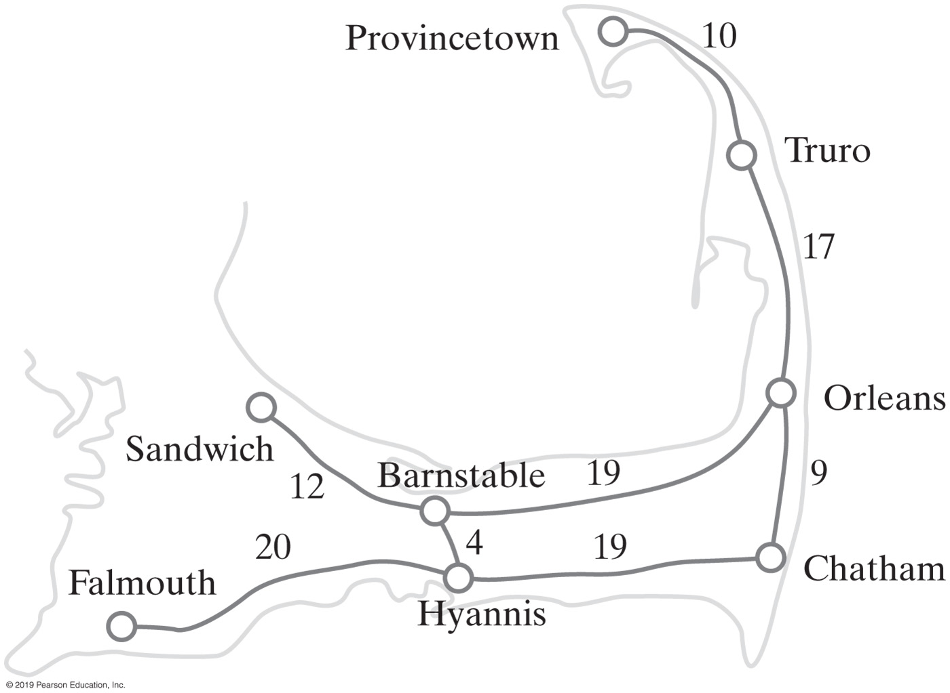
Weighted graph
A graph in which each edge carries a value
FIGURE 29-3 A weighted graph

Slide 13
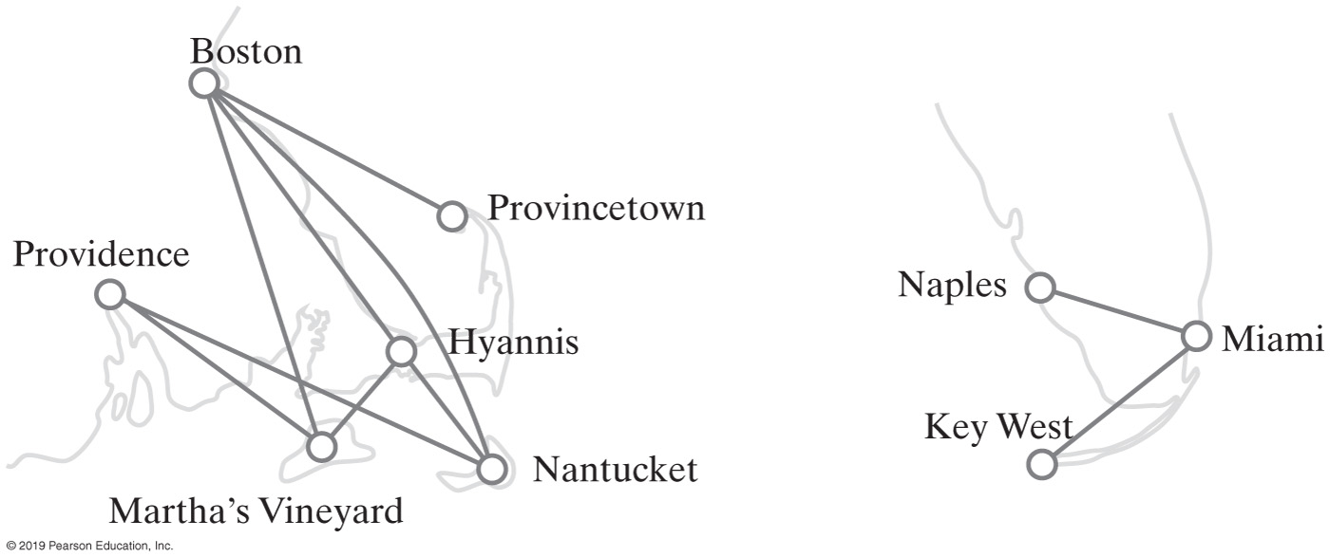
Graphs
FIGURE 29-6 Airline routes

Slide 14
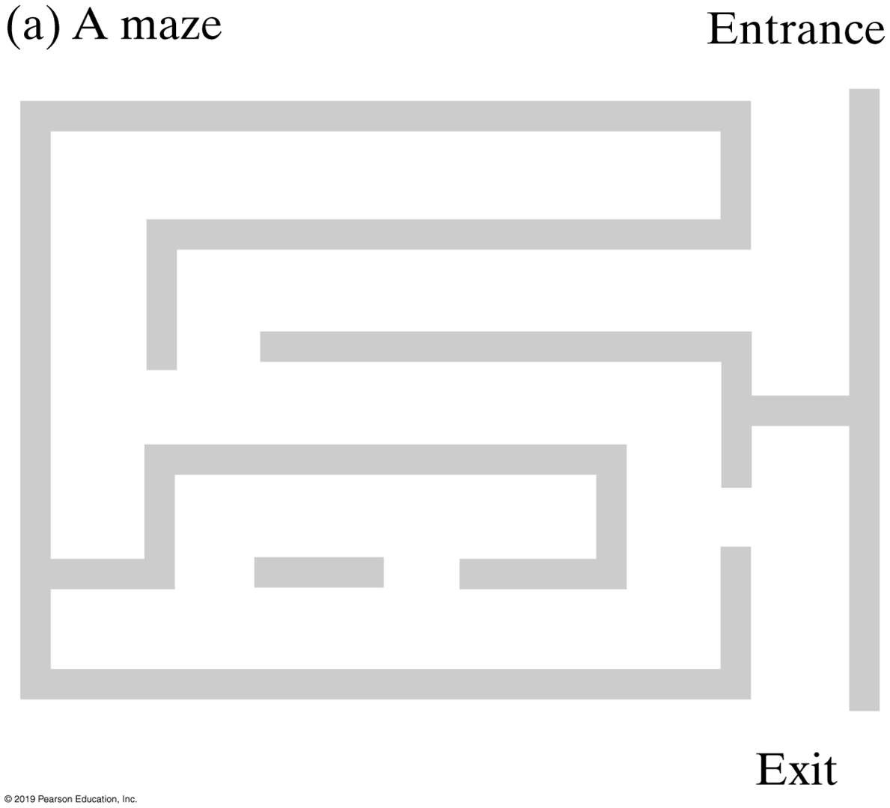
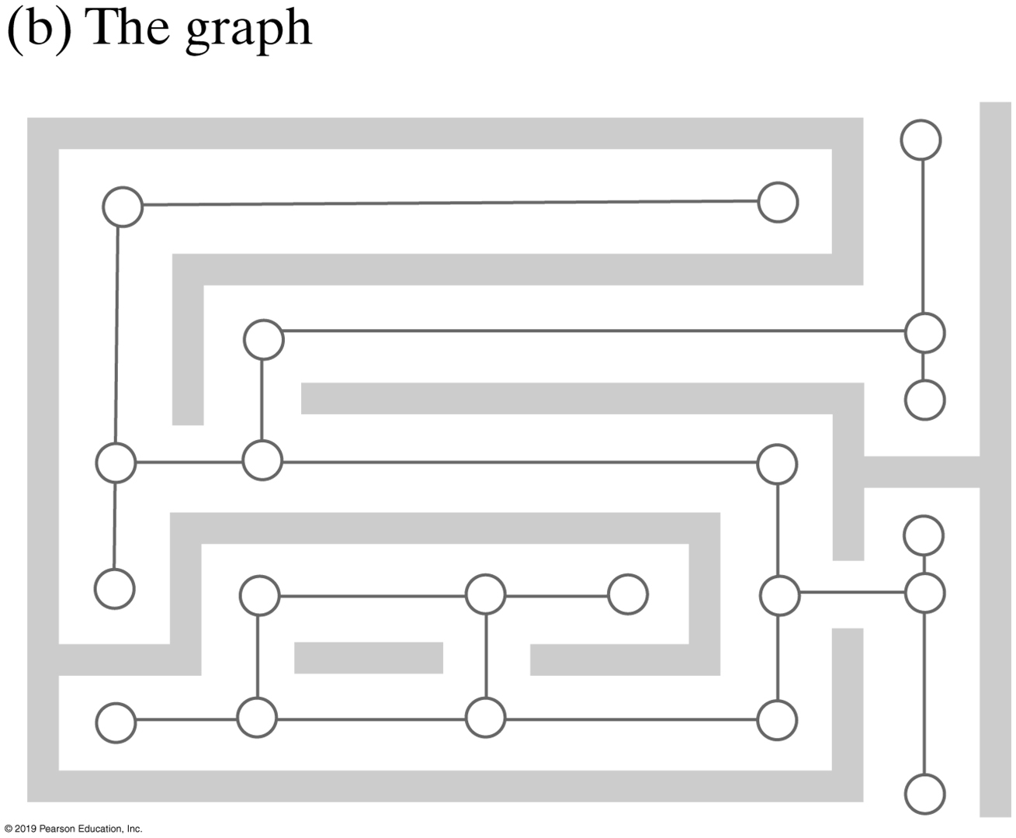
Graphs
FIGURE 29-7 A maze and its representation as a graph

Slide 15
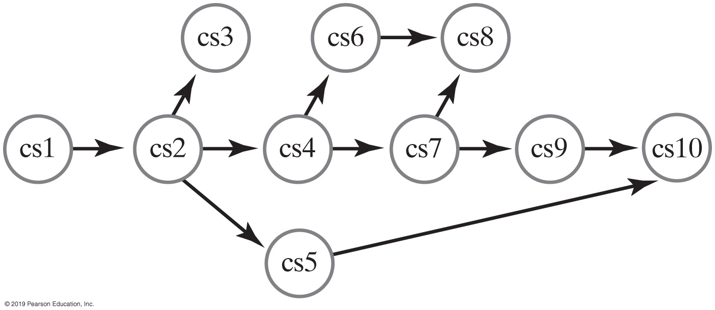
Directed Graphs
FIGURE 29-8 The prerequisite structure for a selection of courses as a directed graph without cycles

Slide 16
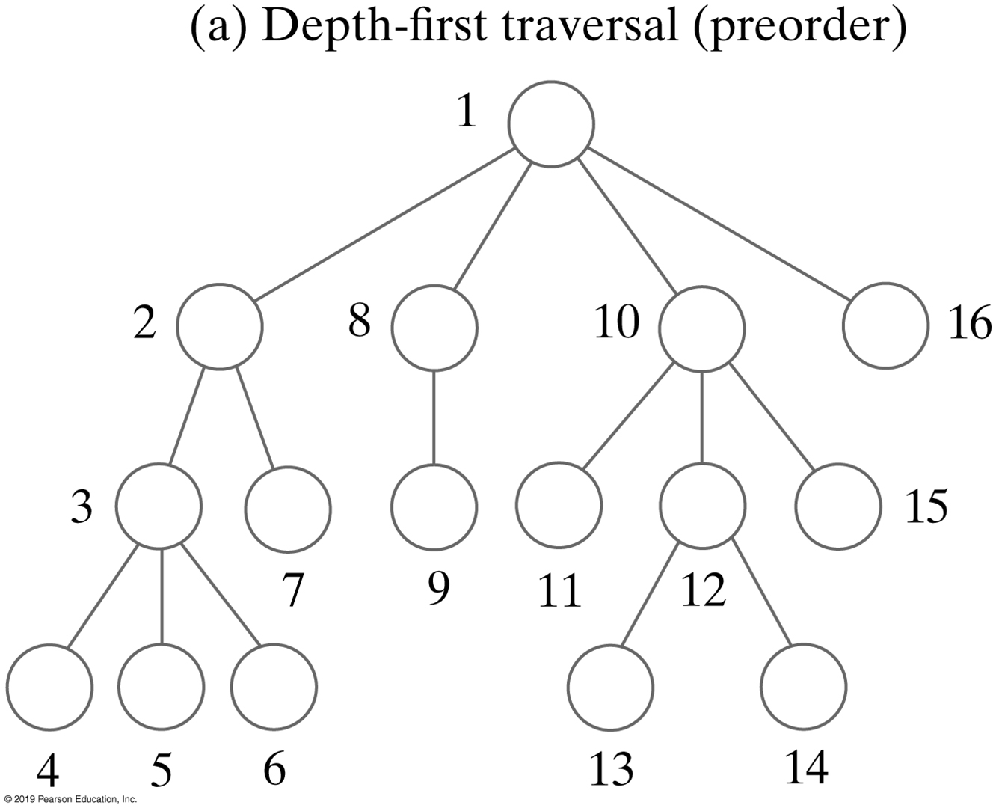
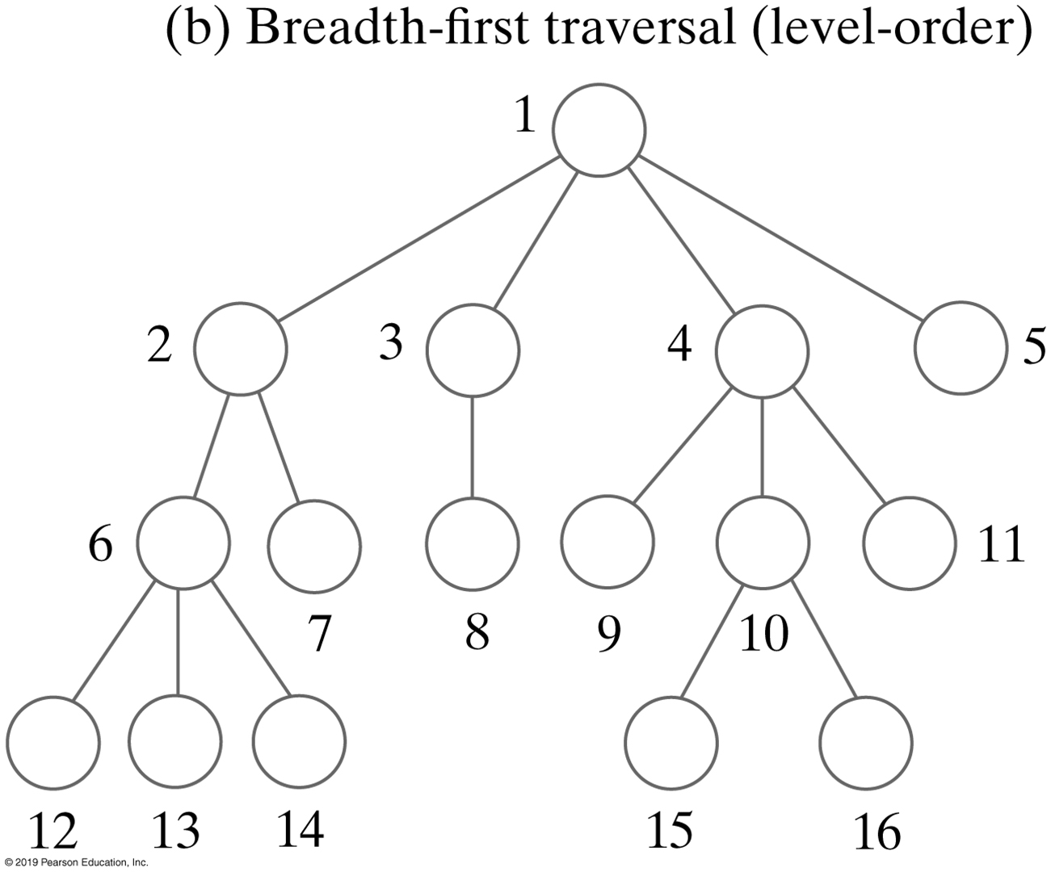
Graph Traversal
FIGURE 29-9 The visitation order of two traversals

Slide 17
Breadth-First Traversal
Algorithm getBreadthFirstTraversal(originVertex)
traversalOrder = a new queue for the resulting traversal order
vertexQueue = a new queue to hold vertices as they are visited
Mark originVertex as visited
traversalOrder.enqueue(originVertex)
vertexQueue.enqueue(originVertex)
while (!vertexQueue.isEmpty())
{
frontVertex = vertexQueue.dequeue()
while (frontVertex has a neighbor)
{
nextNeighbor = next neighbor of frontVertex
if (nextNeighbor is not visited)
{
Mark nextNeighbor as visited
traversalOrder.enqueue(nextNeighbor)
vertexQueue.enqueue(nextNeighbor)
}
}
}
return traversalOrder
Algorithm that performs a breadth-first traversal of a nonempty graph beginning at a given vertex

Slide 18
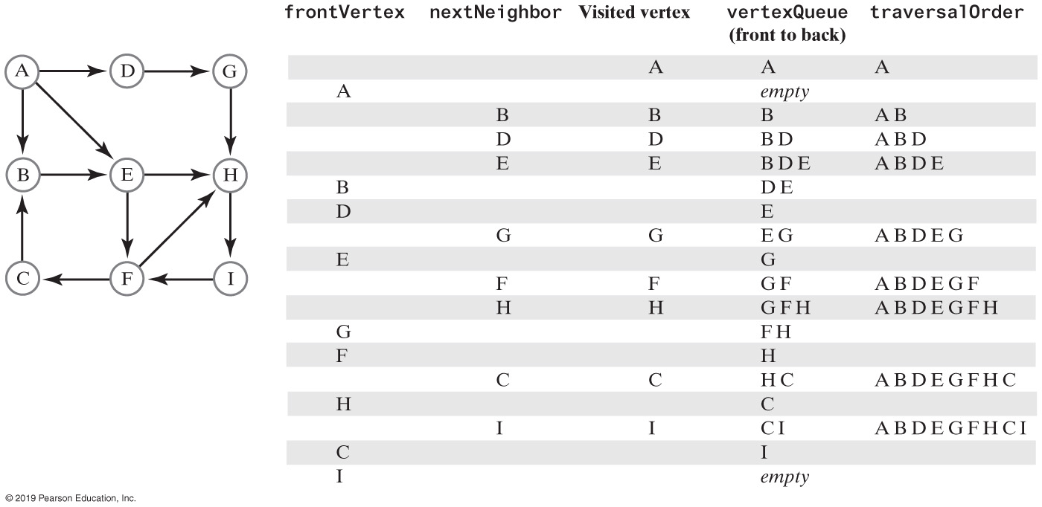
Breadth-First Traversal
FIGURE 29-10 A trace of a breadth-first traversal beginning at vertex A of a directed graph

Slide 19
Depth-First Traversal
Algorithm getDepthFirstTraversal(originVertex)
traversalOrder = a new queue for the resulting traversal order
vertexStack = a new stack to hold vertices as they are visited
Mark originVertex as visited
traversalOrder.enqueue(originVertex)
vertexStack.push(originVertex)
while (!vertexStack.isEmpty())
{
topVertex = vertexStack.peek()
if (topVertex has an unvisited neighbor)
{
nextNeighbor = next unvisited neighbor of topVertex
Mark nextNeighbor as visited
traversalOrder.enqueue(nextNeighbor)
vertexStack.push(nextNeighbor)
}
else // All neighbors are visited
vertexStack.pop()
}
return traversalOrder
Algorithm that performs a depth-first traversal of a nonempty graph, beginning at a given vertex

Slide 20
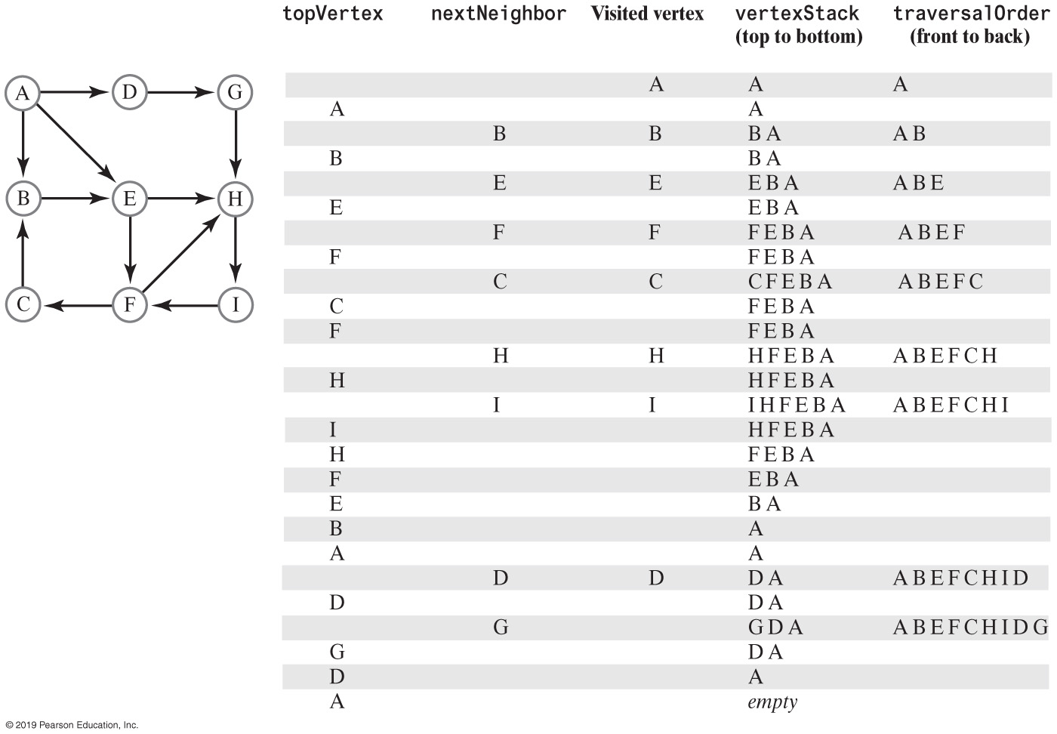
Depth-First Traversal
FIGURE 29-11 A trace of a depth-first traversal beginning at vertex A of a directed graph

Slide 21
Topological Order
Algorithm getTopologicalOrder()
vertexStack = a new stack to hold vertices as they are visited
numberOfVertices = number of vertices in the graph
for (counter = 1 to numberOfVertices)
{
nextVertex = an unvisited vertex whose neighbors, if any, are all visited
Mark nextVertex as visited
vertexStack.push(nextVertex)
}
return vertexStack
An algorithm that describes a topological sort

Slide 22
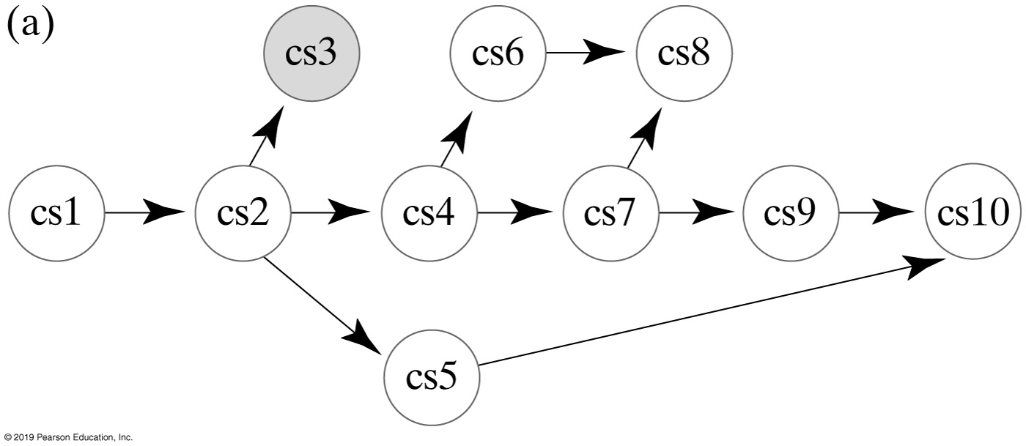
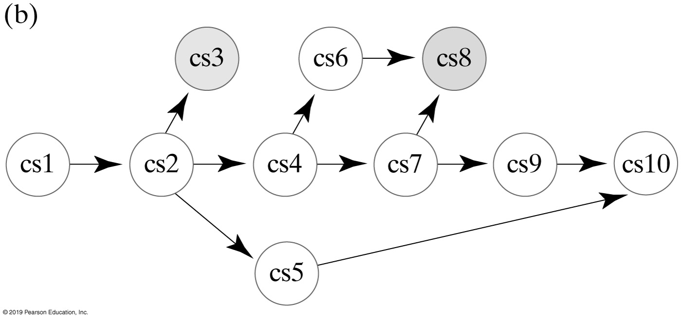
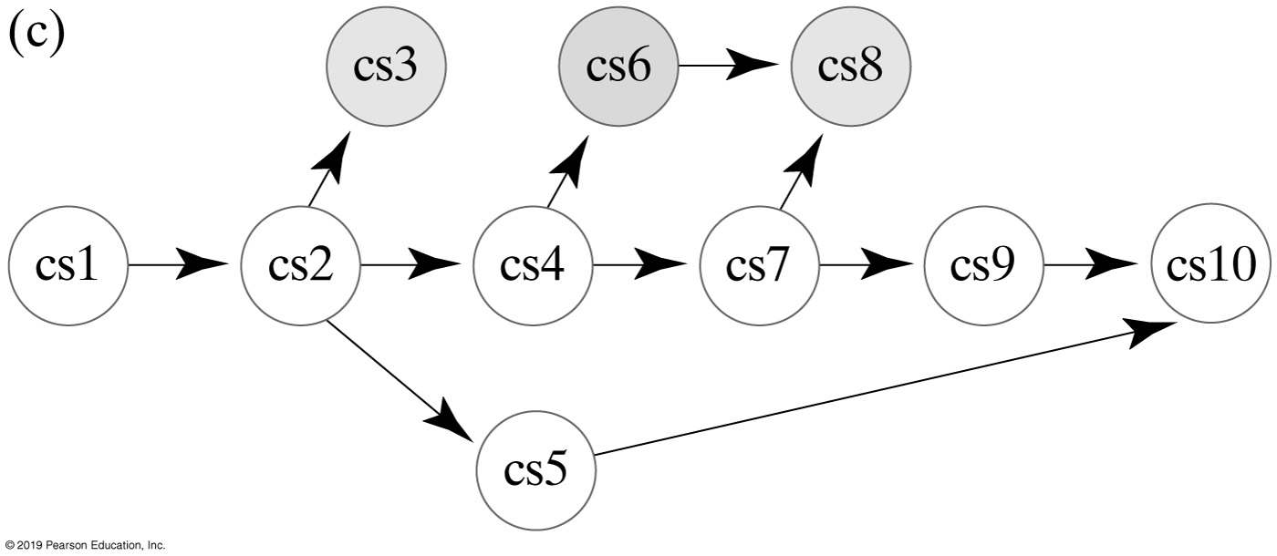
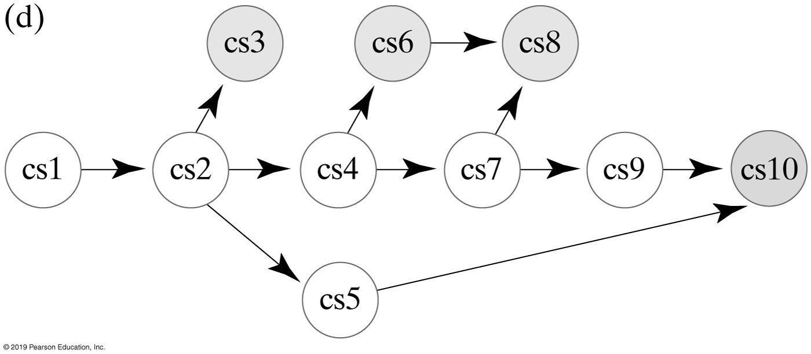
Topological Ordering (Part 1)
Figure 29-8
FIGURE 29-14 Finding a topological order for the graph in Figure 29-8

Slide 23
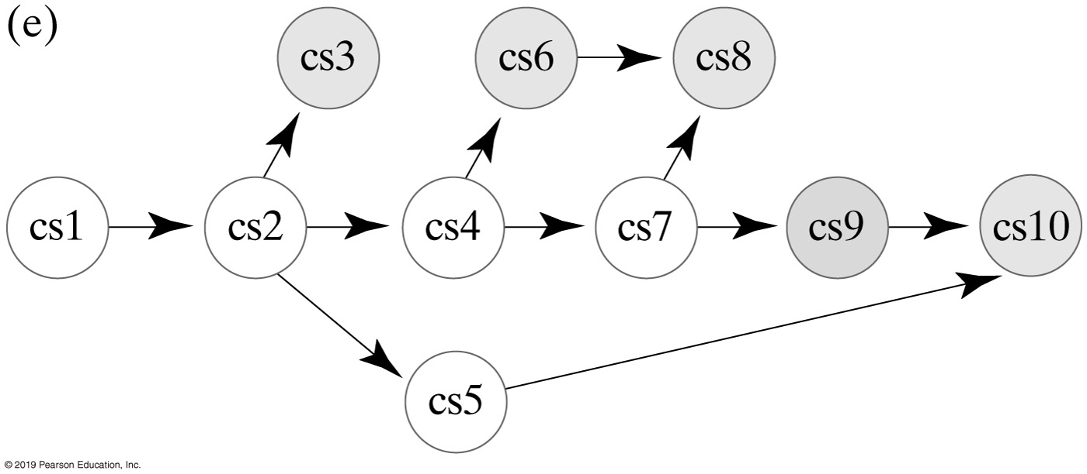
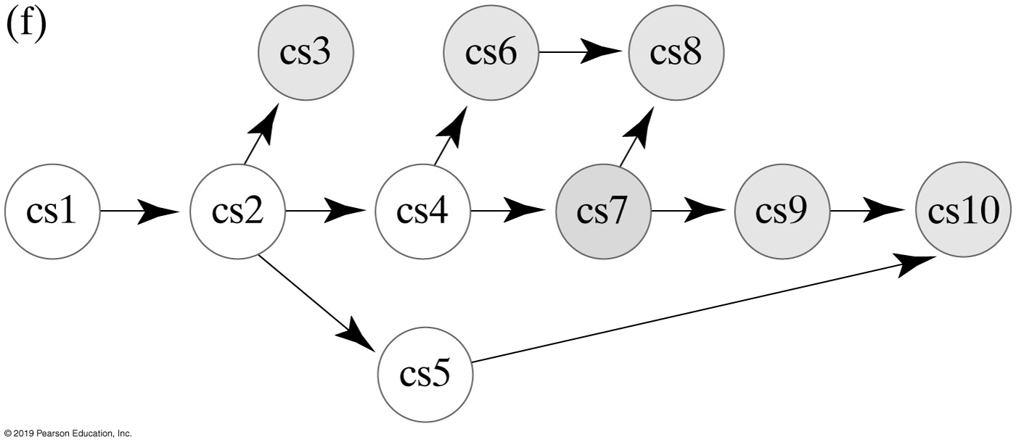
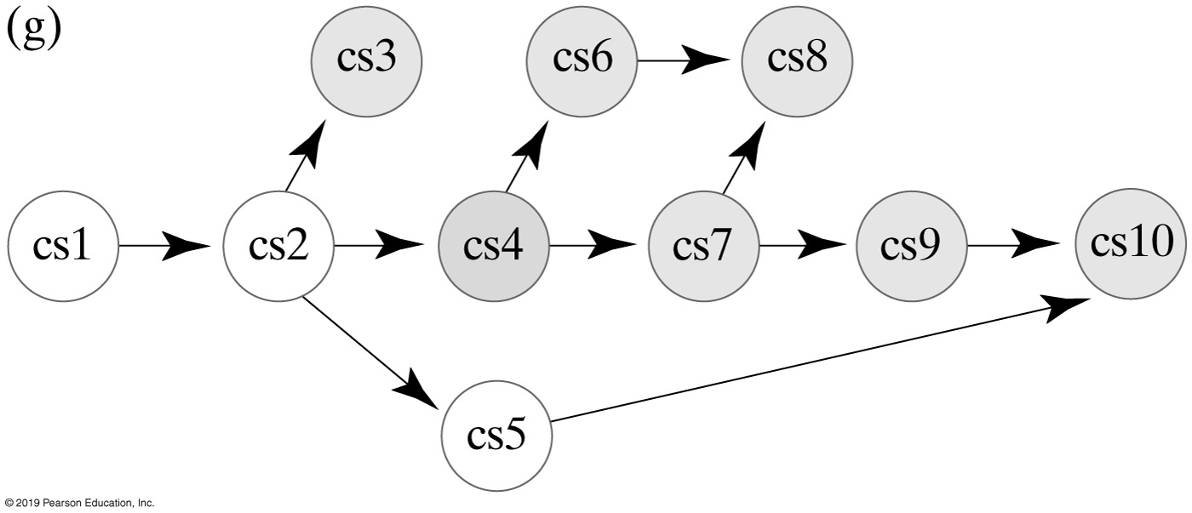
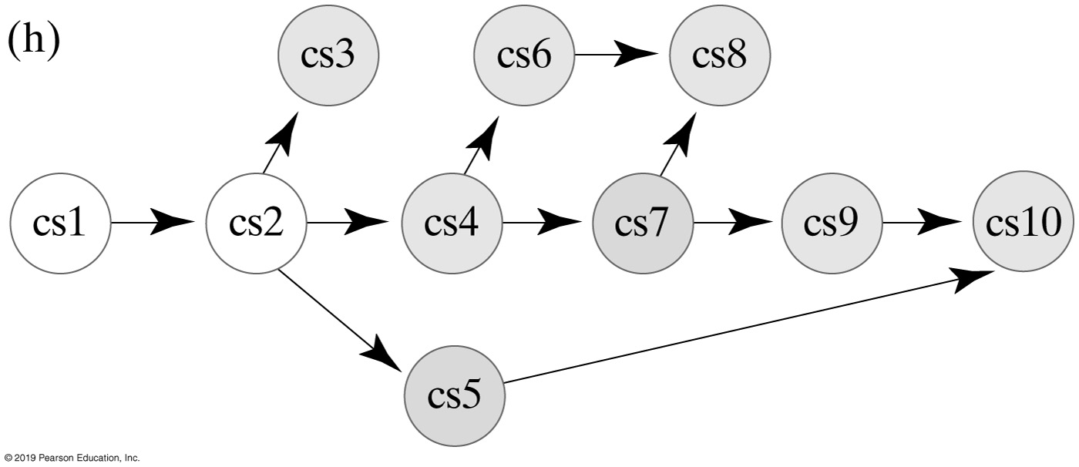
Topological Ordering (Part 2)
Figure 29-8
FIGURE 29-14 Finding a topological order for the graph in Figure 29-8

Slide 24
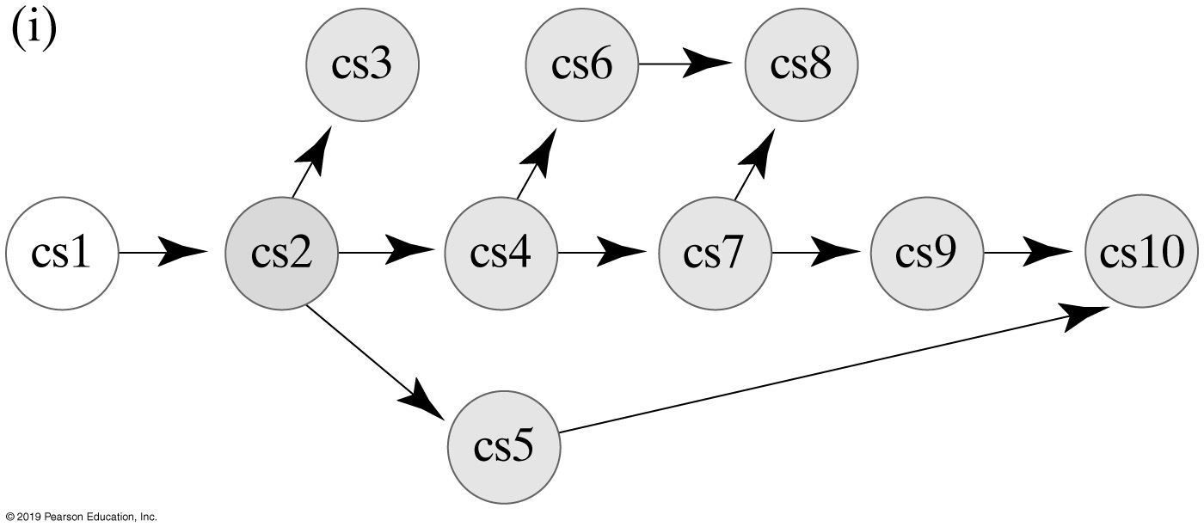
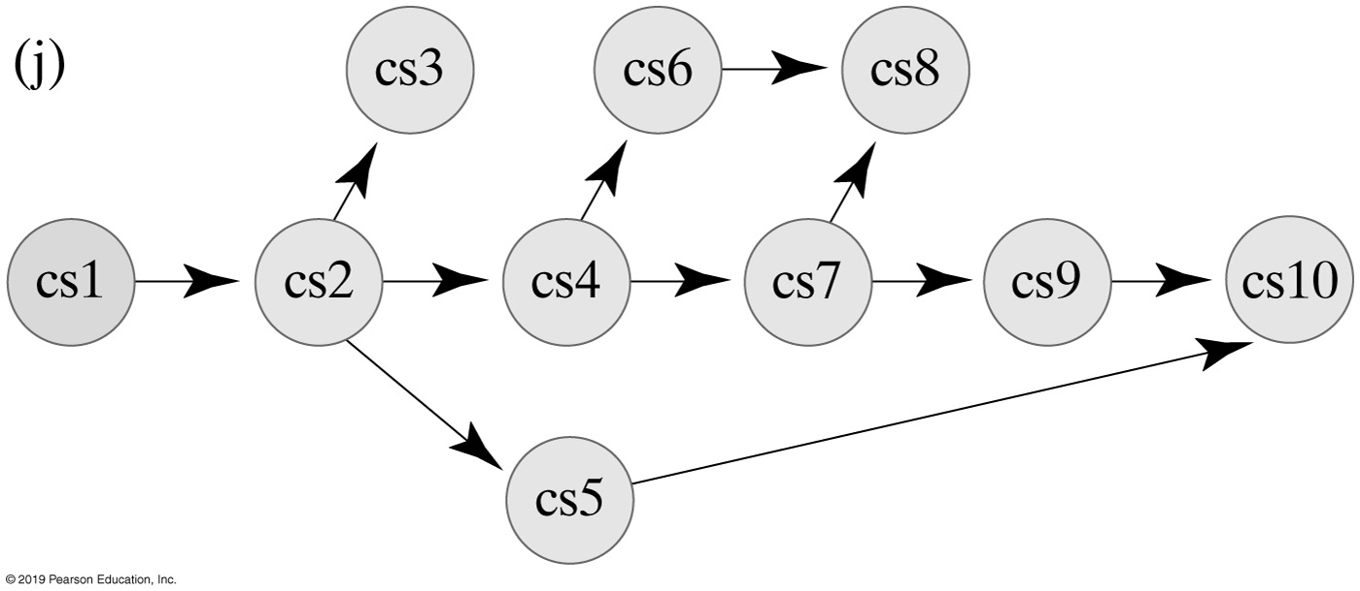
Topological Ordering (Part 3)
Figure 29-8
FIGURE 29-14 Finding a topological order for the graph in Figure 29-8

Slide 25
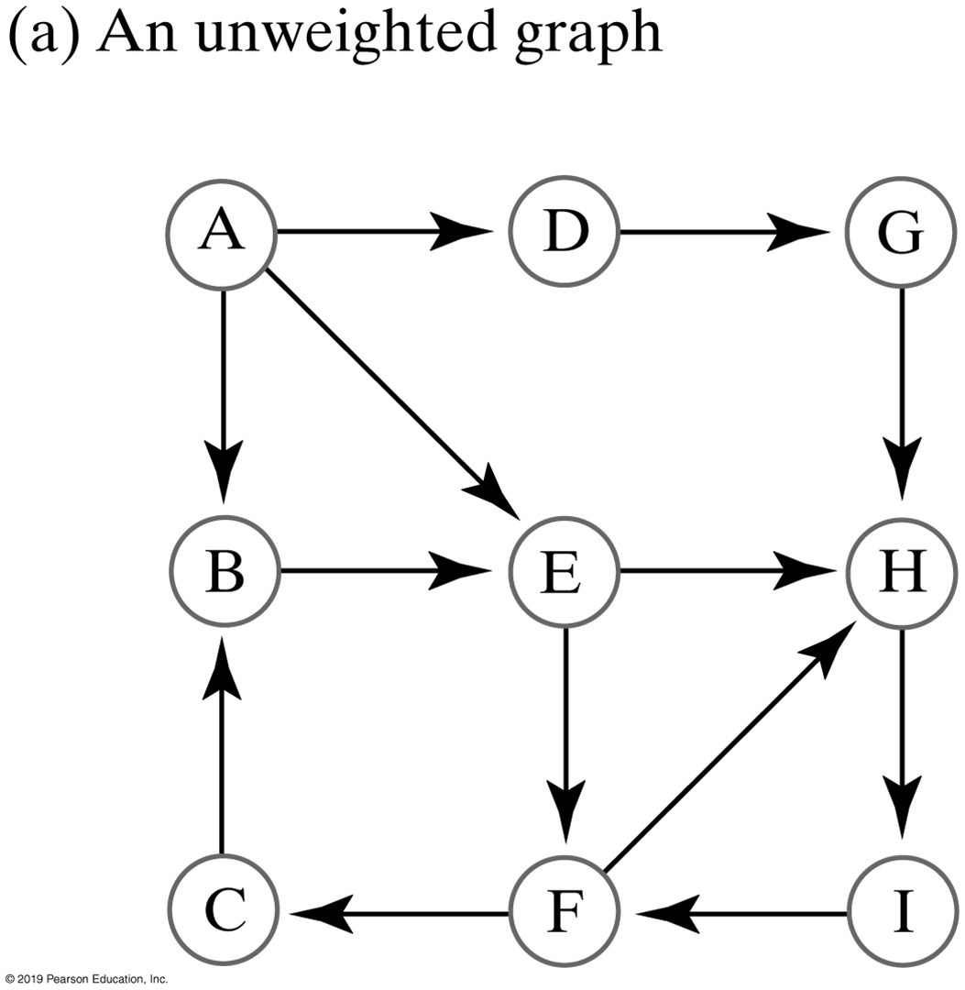
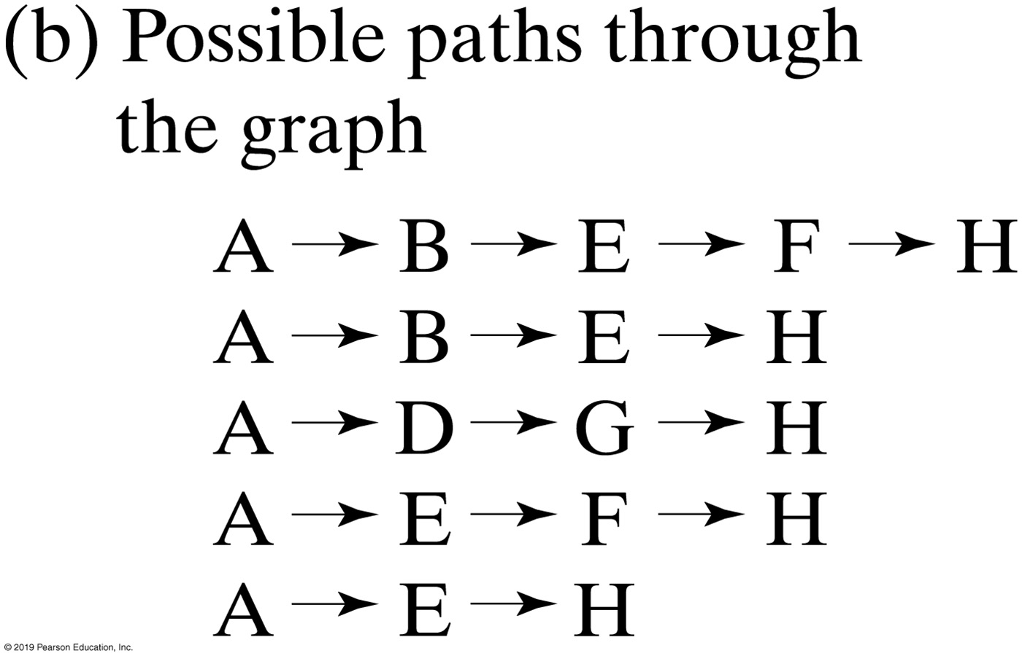
Shortest Path in Unweighted Graph
FIGURE 29-15 An unweighted graph and the possible paths from vertex A to vertex H

Slide 26
Shortest Path in an Unweighted Graph (Part 1)
Algorithm getShortestPath(originVertex, endVertex, path)
done = false
vertexQueue = a new queue to hold vertices as they are visited
Mark originVertex as visited
vertexQueue.enqueue(originVertex)
while (!done && !vertexQueue.isEmpty())
{
frontVertex = vertexQueue.dequeue()
while (!done && frontVertex has a neighbor)
{
nextNeighbor = next neighbor of frontVertex
if (nextNeighbor is not visited)
{
Mark nextNeighbor as visited
Set the length of the path to nextNeighbor to 1 + length of path to frontVertex
Set the predecessor of nextNeighbor to frontVertex
vertexQueue.enqueue(nextNeighbor)
}
if (nextNeighbor equals endVertex)
done = true
}
}
Algorithm to find shortest path

Slide 27
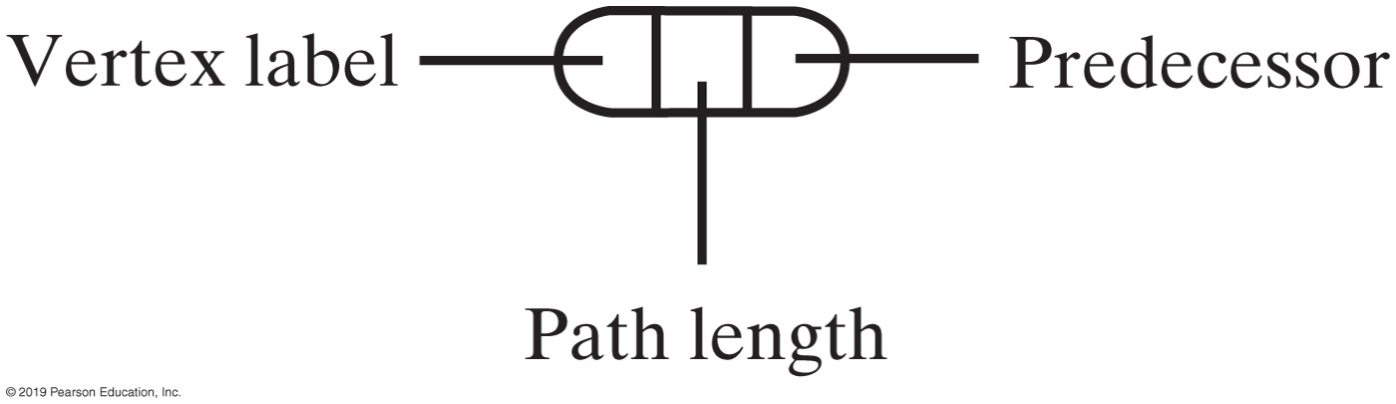
Shortest Path in an Unweighted Graph (Part 2)
// Traversal ends; construct shortest path
pathLength = length of path to endVertex
path.push(endVertex)
vertex = endVertex
while (vertex has a predecessor)
{
vertex = predecessor of vertex
path.push(vertex)
}
return pathLength
Algorithm to find shortest path
FIGURE 29-16 The data in a vertex

Slide 28
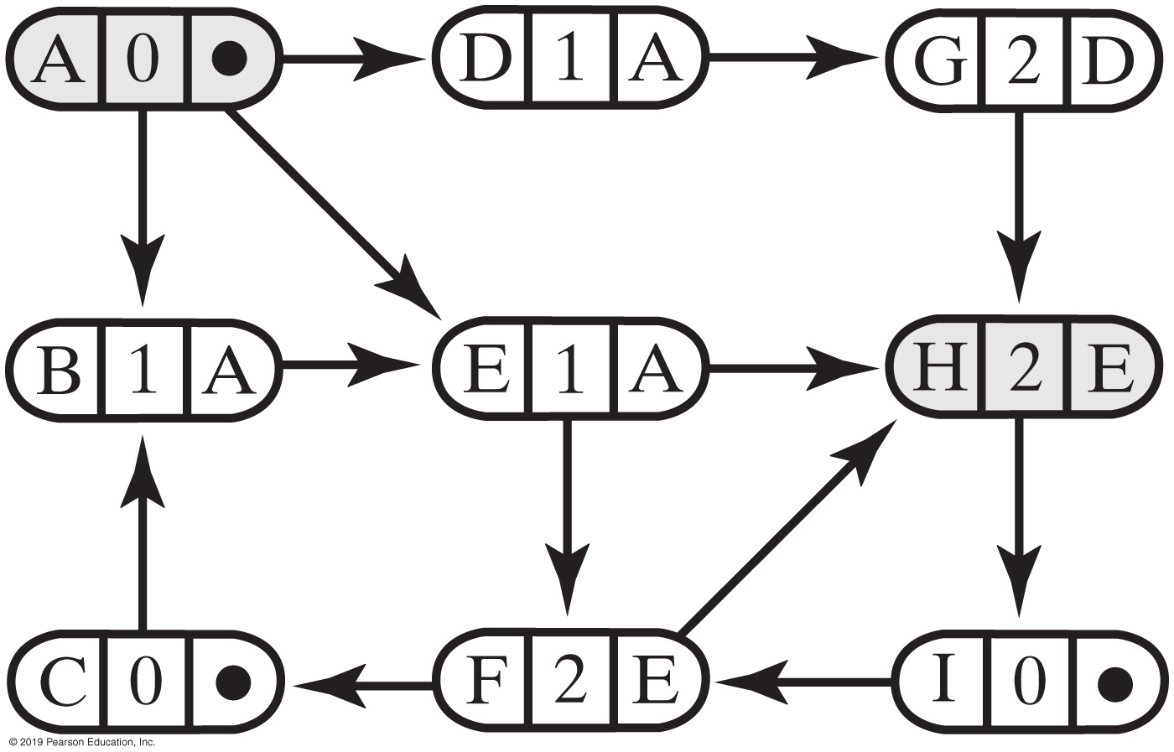
Shortest Path in a Weighted Graph
FIGURE 29-17 The graph in Figure 29-15a after the shortest-path algorithm has traversed from vertex A to vertex H

Slide 29
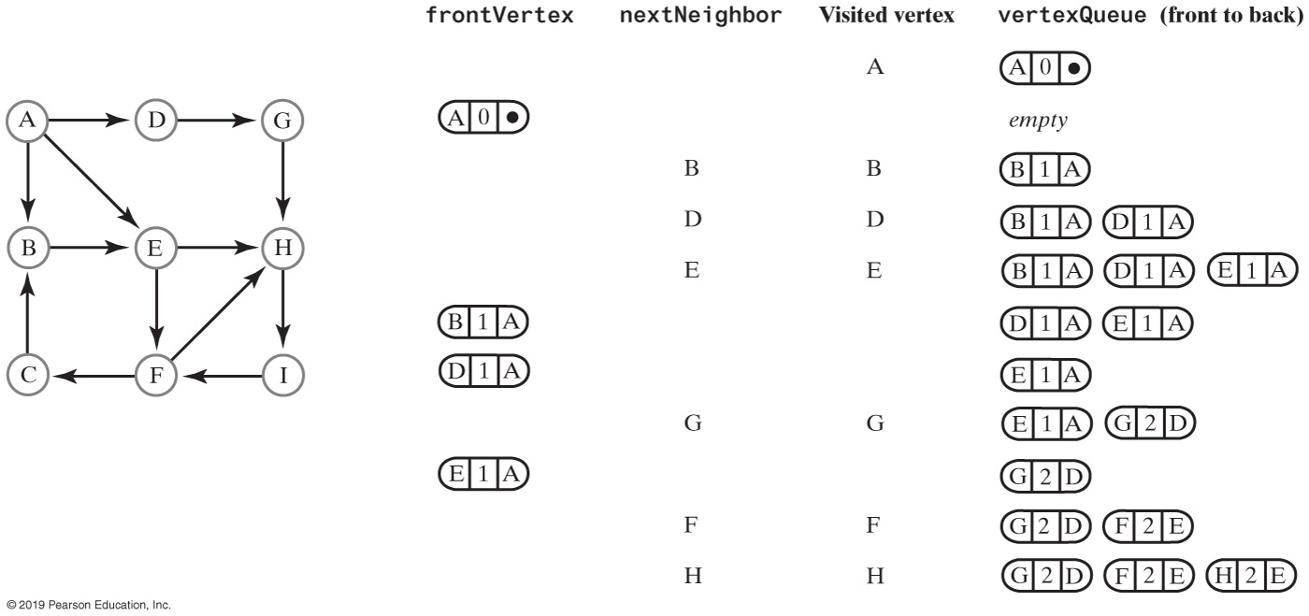
Shortest Path in a Weighted Graph
FIGURE 29-18 A trace of the traversal in the algorithm to find the shortest path from vertex A to vertex H in an unweighted graph

Slide 30
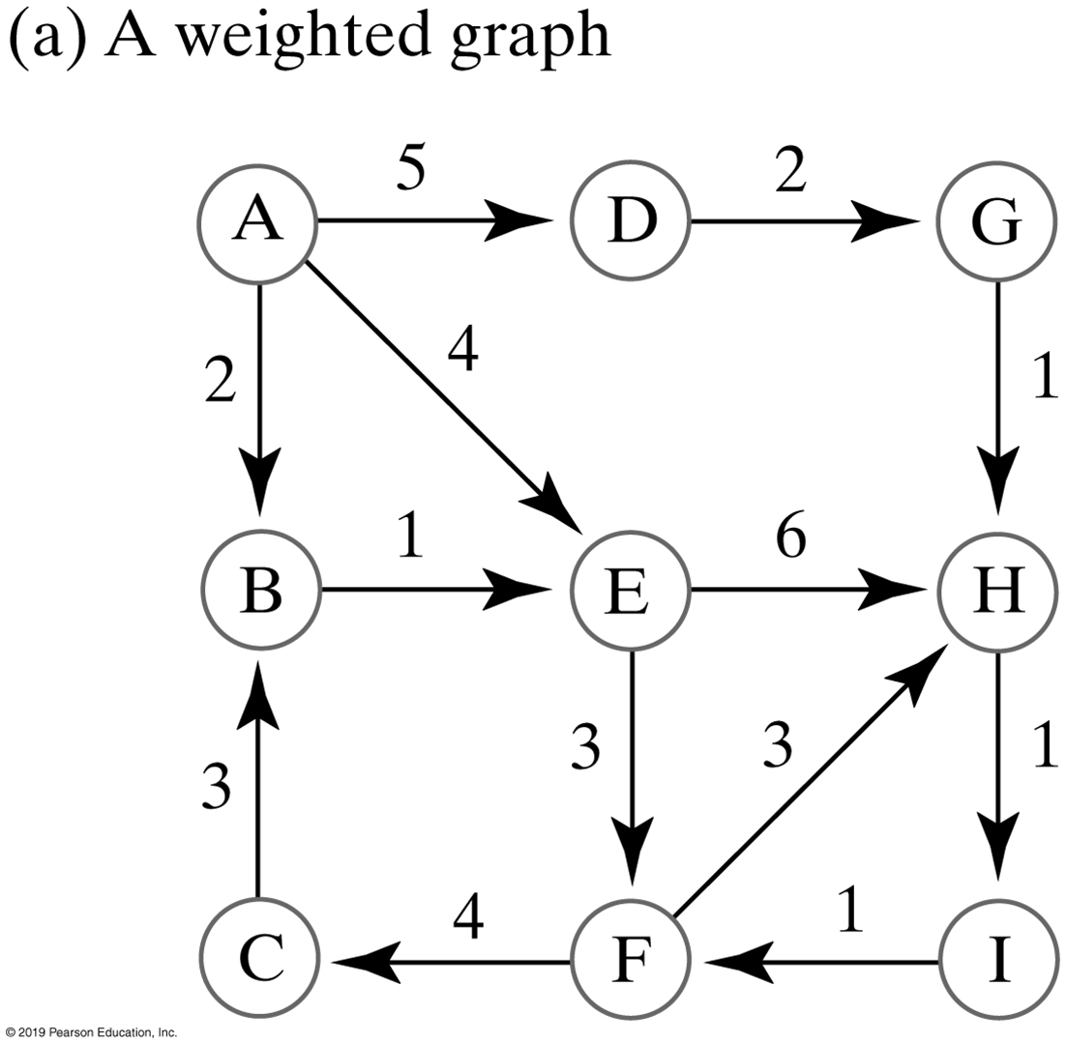
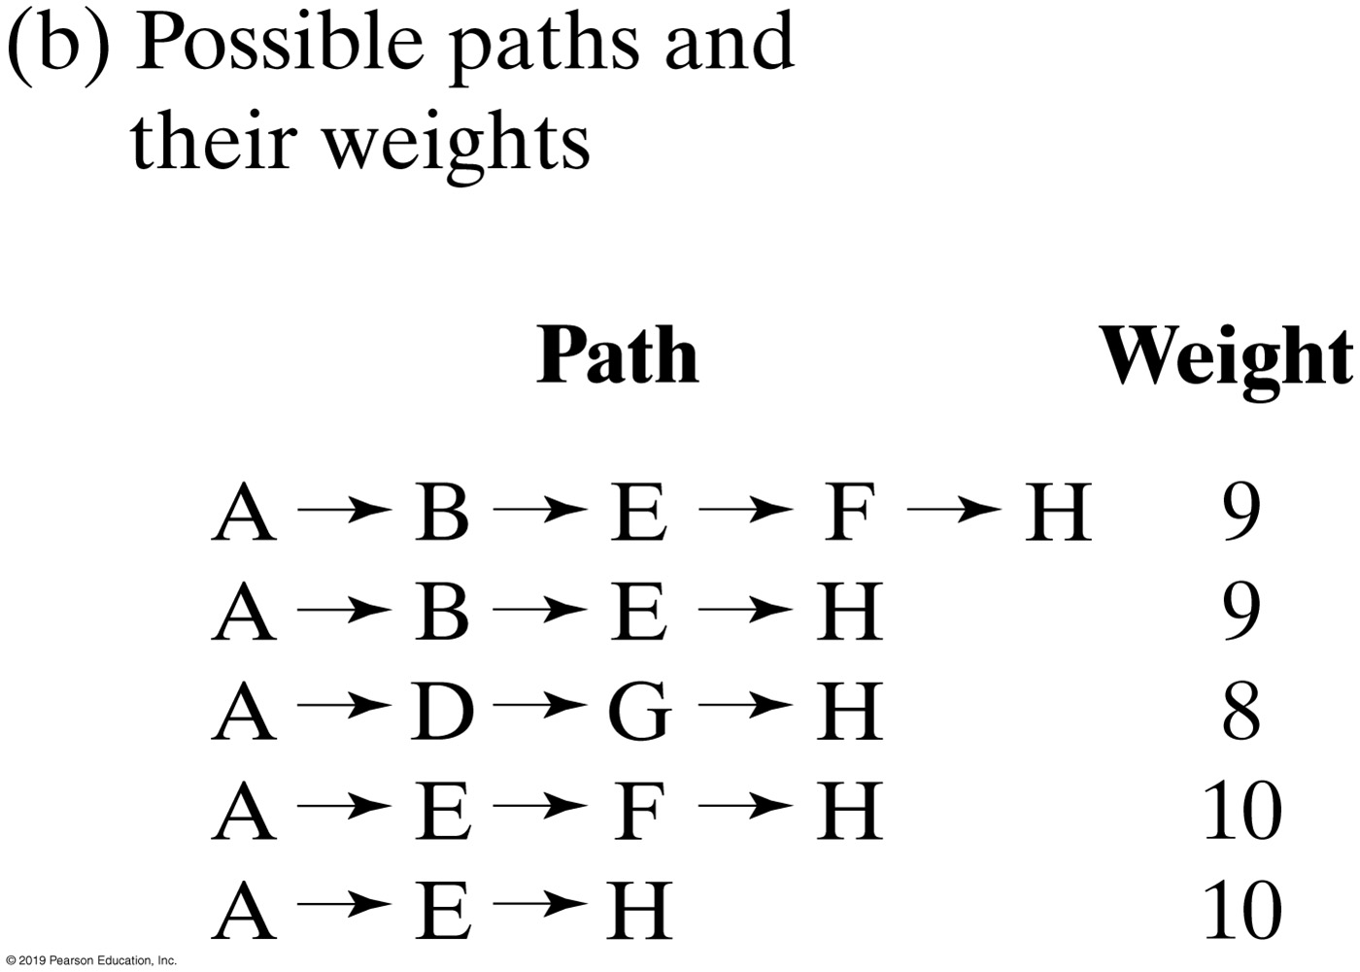
Shortest Path in a Weighted Graph
FIGURE 29-19 A weighted graph and the possible paths from vertex A to vertex H

Slide 31
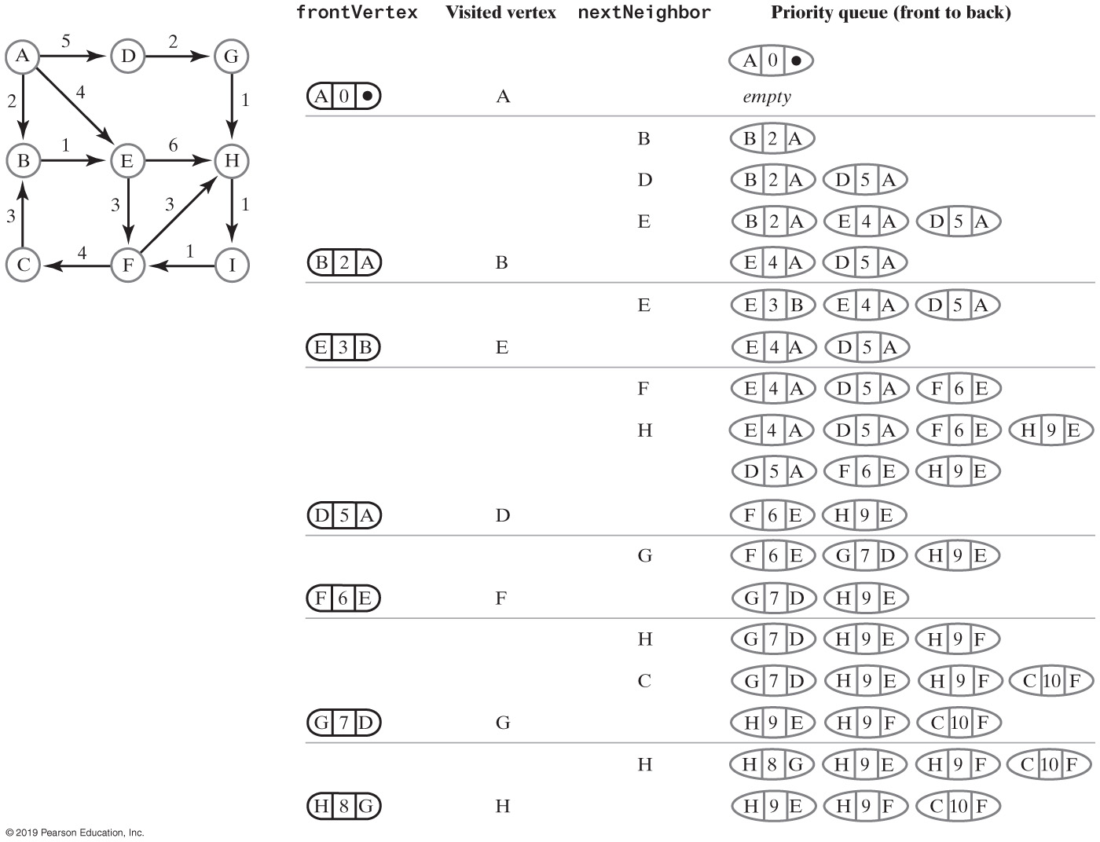
Shortest Path in a Weighted Graph
FIGURE 29-20 A trace of the traversal in the algorithm to find the cheapest path from vertex A to vertex H in a weighted graph

Slide 32
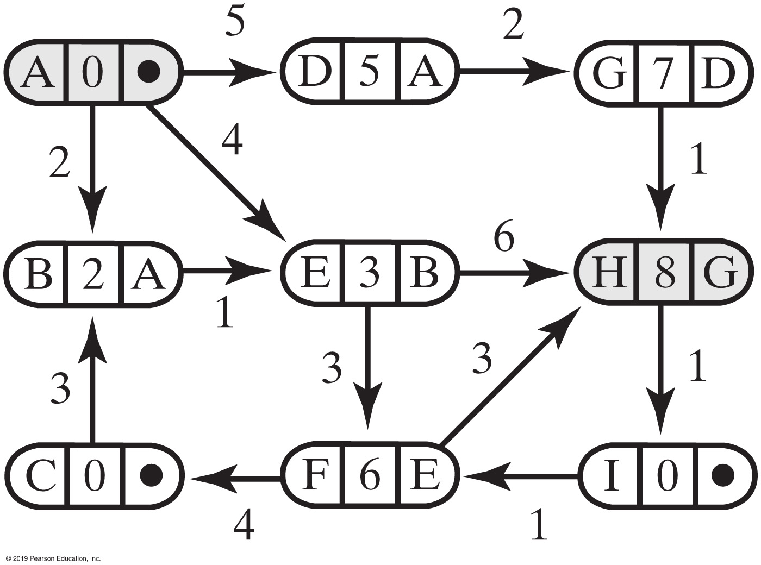
Shortest Path in a Weighted Graph
FIGURE 29-21 The graph in Figure 29-19a after finding the cheapest path from vertex A to vertex H

Slide 33
The Shortest Path in a Weighted Graph (Part 1)
Algorithm getCheapestPath(originVertex, endVertex, path)
done = false
priorityQueue = a new priority queue
priorityQueue.add(new EntryPQ(originVertex, 0, null))
while (!done && !priorityQueue.isEmpty())
{
frontEntry = priorityQueue.remove()
frontVertex = vertex in frontEntry
if (frontVertex is not visited)
{
Mark frontVertex as visited
Set the cost of the path to frontVertex to the cost recorded in frontEntry
Set the predecessor of frontVertex to the predecessor recorded in frontEntry
if (frontVertex equals endVertex)
done = true
else
{
Pseudocode for shortest path (weighted)

Slide 34
The Shortest Path in a Weighted Graph (Part 2)
while (frontVertex has a neighbor)
{
nextNeighbor = next neighbor of frontVertex
weightOfEdgeToNeighbor = weight of edge to nextNeighbor
if (nextNeighbor is not visited)
{
nextCost = weightOfEdgeToNeighbor + cost of path to frontVertex
priorityQueue.add(new EntryPQ(nextNeighbor, nextCost,
frontVertex))
}
}
}
}
}
Pseudocode for shortest path (weighted)

Slide 35
The Shortest Path in a Weighted Graph (Part 3)
// Traversal ends; construct cheapest path
pathCost = cost of path to endVertex
path.push(endVertex)
vertex = endVertex
while (vertex has a predecessor)
{
vertex = predecessor of vertex
path.push(vertex)
}
return pathCost
Pseudocode for shortest path (weighted)

Slide 36
Overview of Two Implementations
Two common implementations of the ADT graph
Array:
Typically a two-dimensional array called an adjacency matrix
List:
Referred to as an adjacency list.

Slide 37
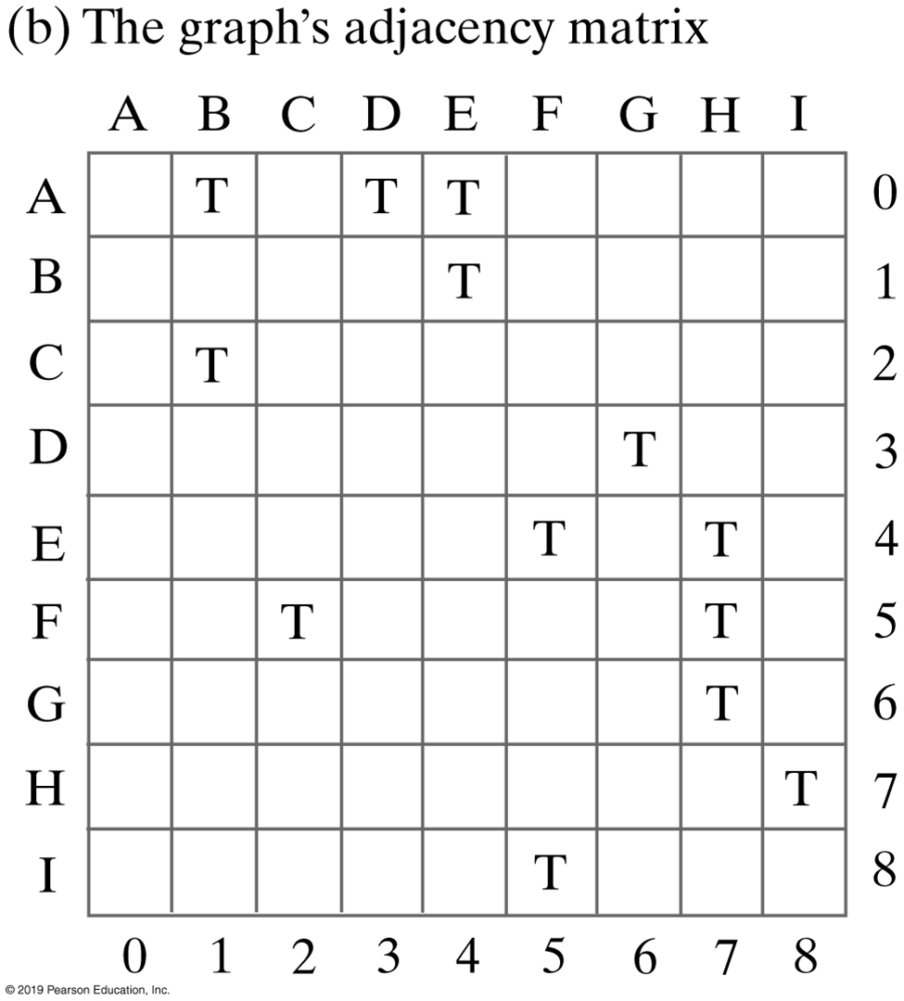
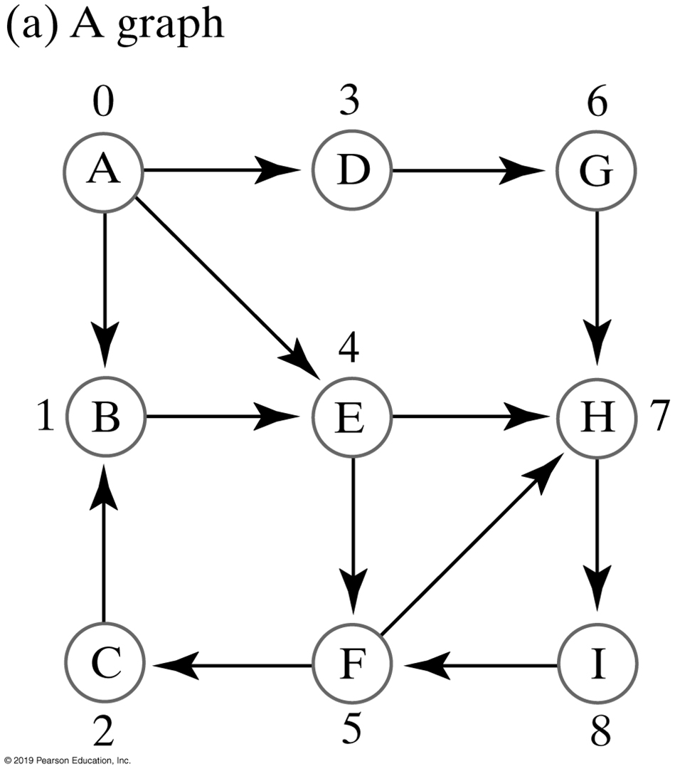
FIGURE 30-1 An unweighted, directed graph and its adjacency matrix

Slide 38
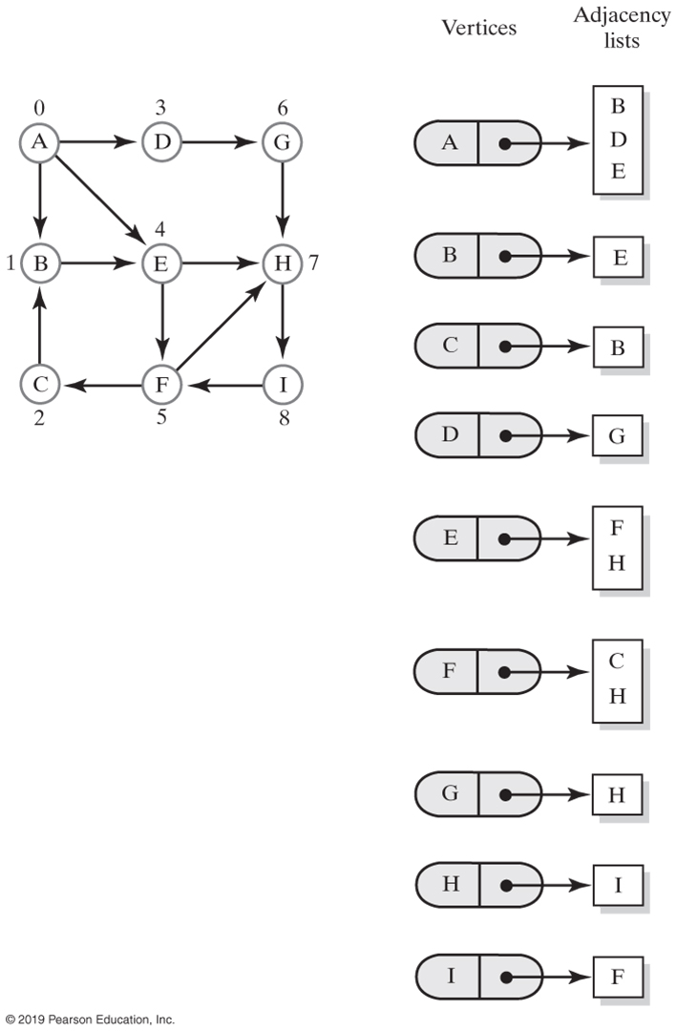
FIGURE 30-2 Adjacency lists for the directed graph in Figure 30-1a

Slide 39
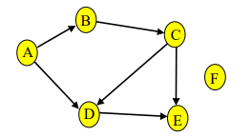
Topological Sort

Slide 40
END

